Slide 1

Data Science: data preprocessing
Module 6CM521: Frontiers in AI and Data Science
Ioannis Tsioulis (MC)
Slides acknowledgements:
Dr Hong Qing Yu

Slide 2
Declaration
The lecture slides are based on the book: Data Mining: Concepts and Techniques (Han, Kamber and Pei), Chapter 3

Slide 3
Agenda
Why preprocess the data?
Data cleaning
Data integration and transformation
Data reduction
Summary

Slide 4
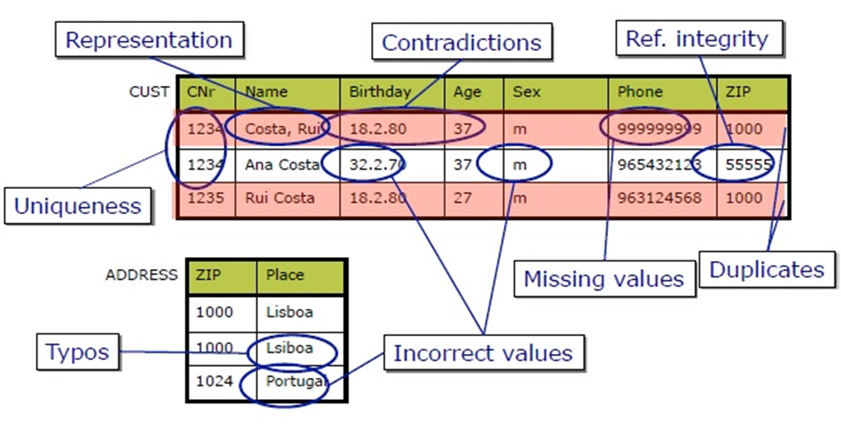
Why Data Preprocessing?
Data in the real world is dirty! Missing, noisy and inconsistent data.
Notes:
Missing data: you can also see this as inaccurate data since the information that isn’t there creates gaps that might be relevant to the final analysis. Missing data often appears when there’s a problem in the collection phase, such as a glitch that caused a system’s downtime, mistakes in data entry, or issues with biometrics use, among others.
Noisy data: this group encompasses erroneous data and outliers that you can find in the data set but that is just meaningless information. Here you can see noise made of human mistakes, rare exceptions, mislabels, and other issues during data gathering.
Inconsistent data: inconsistencies happen when you keep files with similar data in different formats and files. Duplicates in different formats, mistakes in codes of names, or the absence of data constraints often lead to inconsistent data, that introduces deviations that you have to deal with before analysis.

Slide 5
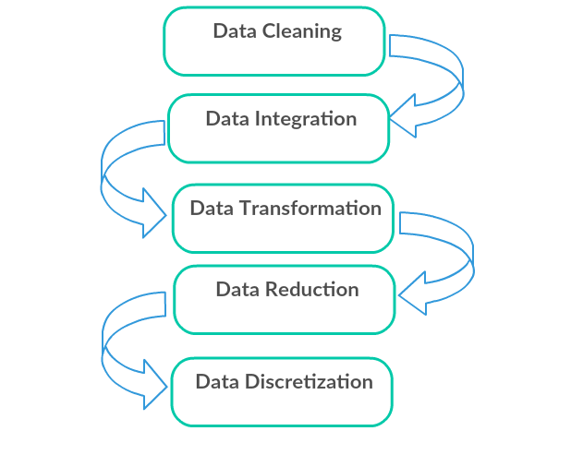
Major Tasks in Data Preprocessing
Data cleaning
  Fill in missing values, smooth noisy data, identify or remove outliers, and resolve inconsistencies
Data integration
  Integration of multiple databases, data cubes, or files
Data transformation
  Normalization (scaling to a specific range)
  Aggregation
Data reduction
  Obtains reduced representation in volume but produces the same or similar analytical results
Data discretization
  With particular importance, especially for numerical data
  We will practise this in Week 3 (pd.cut)

Slide 6
Agenda
Why preprocess the data?
Data cleaning
Data integration and transformation
Data reduction
Summary

Slide 7

Data Cleaning
Data cleaning tasks
  Fill in missing values
  Identify outliers and smooth out noisy data
  Correct inconsistent data

Slide 8
Missing Data
Data is not always available
  E.g., many tuples have no recorded value for several attributes, such as customer income in sales data
Missing data may be due to
  equipment malfunction
  inconsistent with other recorded data and thus deleted
  data not entered due to misunderstanding
  certain data may not be considered important at the time of entry
  history or changes of the data not registered
Missing data may need to be inferred

Slide 9
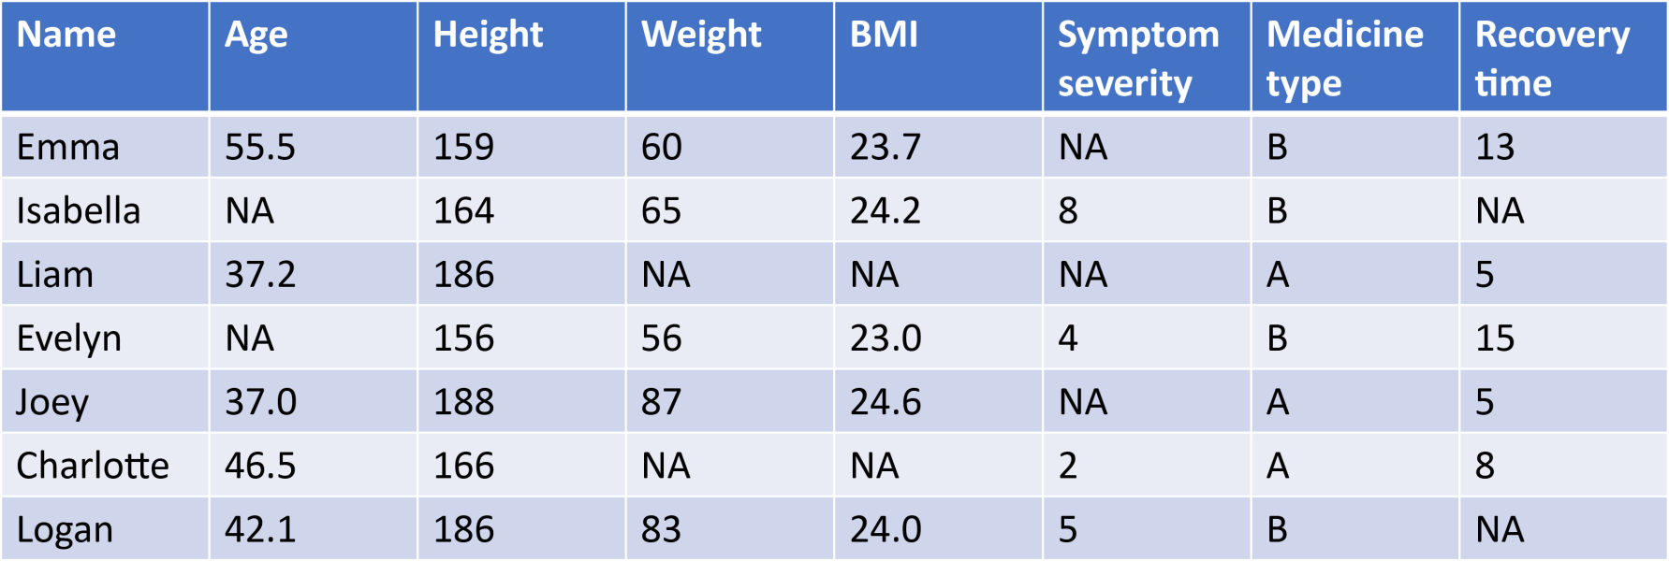
Missing Data Example

Slide 10
How to Handle Missing Data?
Ignore the tuple: usually done when class label is missing (assuming the task is classification—not effective in certain cases)
Fill in the missing value manually: tedious + infeasible?
Use a global constant to fill in the missing value: e.g., “unknown”, a new class?!
Use the attribute mean to fill in the missing value
Use the attribute mean for all samples of the same class to fill in the missing value: smarter
Use the most probable value to fill in the missing value: inference-based such as regression, Bayesian formula, decision tree

Slide 11
Different kinds of missing data
Data missing completely at random (MCAR): missingness does not depend on any values of the missing or measured data. That is missingness r_{i} does not depend on the (unobserved) value y_{i} or on observed values x_{i}. In this case, entities with missing data can be removed from the analysis safely.
Data missing at random (MAR): missingness r_{i} does not depend on value of y_{i}, but may depend on the value of x_{i}. Here, removing data can bias analysis since you would drop values of x based on missingness and potentially change the distribution of x.
Data not missing at random (NMAR): missingness r_{i} depends on y_{i}. This is the most pernicious of all, and usually means that we want to go back to our collaborator and tell them that we are in a bind. Removing or imputing data as discussed is not appropriate in this case.

Slide 12
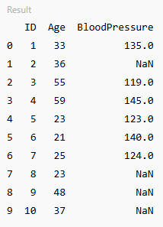
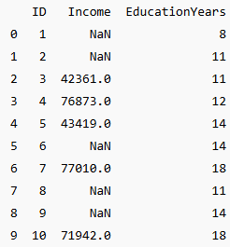
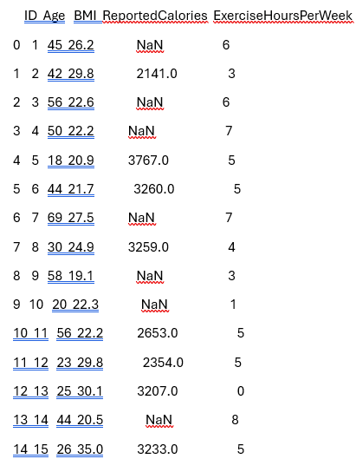
Missing data examples

Slide 13
Noisy Data
Q: What is noise?
A: Random error in a measured variable.
Incorrect attribute values may be due to
  faulty data collection instruments
  data entry problems
  data transmission problems
  technology limitation
  inconsistency in naming convention

Slide 14
How to Handle Noisy Data?
If the entire dataset contains lots of noisy data, then use Binning method:
  first sort data and partition into (equi-depth) bins
  then one can smooth by bin means, smooth by bin medians, smooth by bin boundaries, etc.
  used also for discretization (practised in Week 3)
If the dataset contains some outlier noisy data, then:
Clustering: detect and remove outliers
Semi-automated method: combined computer and human inspection that detects suspicious values, which are then checked manually
Regression: smooth by fitting the data into regression functions

Slide 15
Cluster Analysis

Slide 16
Regression
y
Y1
Y1’
y = x + 1
X1
x
Linear regression (best line to fit
two variables)
Multiple linear regression (more
than two variables, fit to a multidimensional surface)

Slide 17
How to Handle Inconsistent Data?
Manual correction using external references
Semi-automatic using various tools
  To detect violation of known functional dependencies and data constraints
  To correct redundant data

Slide 18
Agenda
Why preprocess the data?
Data cleaning
Data integration and transformation
Data reduction
Summary

Slide 19
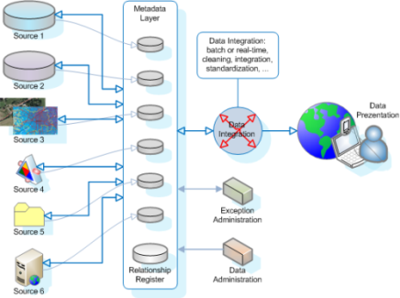
Data Integration Challenges
Multiple sources
Metadata
Management

Slide 20
Data Integration
Data integration:
  combines data from multiple sources into a coherent store
Schema integration
  integrate metadata from different sources
  Entity identification problem: identify real world entities from multiple data sources, e.g., A.cust-id ≡ B.cust-#
Detecting and resolving data value conflicts
  for the same real world entity, attribute values from different sources are different
  possible reasons: different representations, different scales, e.g., metric vs. British units, different currency

Slide 21
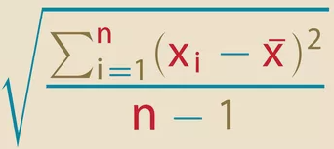
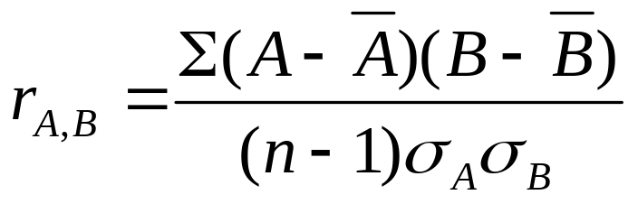
Handling Redundant Data in Data Integration
Redundant data occur often when integrating multiple DBs
  The same attribute may have different names in different databases
  One attribute may be a “derived” attribute in another table, e.g., annual revenue
Redundant data can often be detected by correlation analysis
Careful integration can help reduce/avoid redundancies and inconsistencies and improve mining speed and quality
Notes:
A bar and B bar (Ā, B̄) are the mean values of A and B.
σA and σB (sigma A and sigma B) are the respective standard deviations of A and B, and n is the number of tuples.

Slide 22
Data Transformation
Normalization: scaled to fall within a small, specified range
  min-max normalization
  z-score normalization
  normalization by decimal scaling
Attribute/feature construction
  New attributes constructed from the given ones

Slide 23
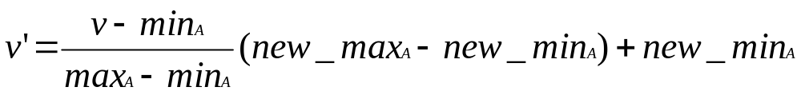
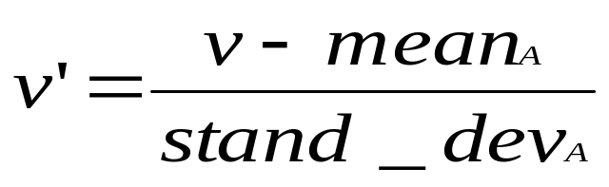
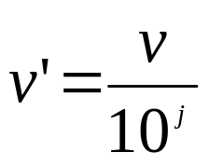

Data Transformation: Normalization
Particularly useful for classification (neural networks, distance-based
methods such as nearest-neighbour classification, etc.)
min-max normalization
z-score normalization
normalization by decimal scaling
Where j is the smallest integer such that Max(| |)<1
Notes:
Suppose that the mean and standard deviation of the value for the attribute income are $54,000 and $16,000, with z-score normalisation a value of $73,600 for incomes is transformed to (73600-54000)/16000=1.225
Normalization by Decimal scaling
Let the input data be: -10, 201, 301, -401, 501, 601, 701
To normalize the above data,
Step 1: Maximum absolute value in given data (m): 701
Step 2: Divide the given data by 1000 (i.e. j = 3)
Result: The normalized data is: -0.01, 0.201, 0.301, -0.401, 0.501, 0.601, 0.701

Slide 24
Agenda
Why preprocess the data?
Data cleaning
Data integration and transformation
Data reduction
Summary

Slide 25
Data Reduction
Problem:
Big Data may store terabytes of data: Complex data analysis/mining may take a very long time to run on the complete data set
Solution?
  Data reduction…

Slide 26
Data Reduction
Obtains a reduced representation of the data set that is much smaller in volume but yet produces the same (or almost the same) analytical results
Data reduction strategies
  Data cube aggregation
  Dimensionality reduction
  Data compression
  Numerosity reduction
  Discretization and concept hierarchy generation

Slide 27
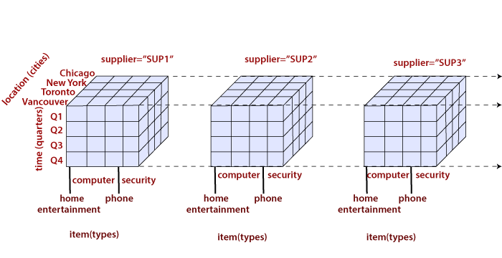
Data Cube Aggregation
Multiple levels of aggregation in data cubes
  Further reduce the size of data to deal with
Reference appropriate levels
  Use the smallest representation capable of solving the task
Queries regarding aggregated information should be answered using data cube, when possible

Slide 28
Dimensionality Reduction
Problem: Feature selection (i.e., attribute subset selection):
  Select a minimum set of features such that the probability distribution of different classes given the values for those features is as close as possible to the original distribution given the values of all features
  Nice side-effect: reduces # of attributes in the discovered patterns (which are now easier to understand)
Solution: Heuristic methods (due to exponential # of choices) usually greedy:
  step-wise forward selection
  step-wise backward elimination
  combining forward selection and backward elimination
  decision-tree induction

Slide 29
Data Compression
String compression
  There are extensive theories and well-tuned algorithms
  Typically lossless
  But only limited manipulation is possible without expansion
Audio/video, image compression
  Typically lossy compression, with progressive refinement
  Sometimes small fragments of signal can be reconstructed without reconstructing the whole
Time sequence is not audio
  Typically short and vary slowly with time

Slide 30
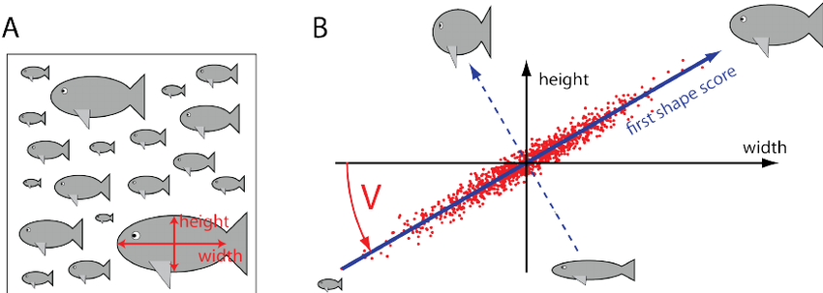
Principal Component Analysis
PCA
The principal components (new set of axes) give important information about variance.
Using the strongest components one can reconstruct a good approximation of the original signal.

Slide 31
Numerosity Reduction
Reduce data volume by choosing alternative, smaller forms of data representation
Parametric methods
  Assume the data fits some model, estimate model parameters, store only the parameters, and discard the data (except possible outliers)
Non-parametric methods
  Do not assume models
  Major families: histograms, clustering, sampling

Slide 32
Sampling
Allow a mining algorithm to run in complexity that is potentially sub-linear to the size of the data
Cost of sampling: proportional to the size of the sample, increases linearly with the number of dimensions
Choose a representative subset of the data
  Simple random sampling may have very poor performance in the presence of skew
Develop adaptive sampling methods
  Stratified sampling:
    Approximate the percentage of each class (or subpopulation of interest) in the overall database
    Used in conjunction with skewed data
Sampling may not reduce database I/Os (page at a time).
Sampling: natural choice for progressive refinement of a reduced data set.

Slide 33
Sampling
Raw Data
Cluster/Stratified Sample

Slide 34
Agenda
Why preprocess the data?
Data cleaning
Data integration and transformation
Data reduction
Summary

Slide 35
Summary
Data preparation is a big issue for data mining but the important steps for not very big data are handling missing data, noisy data and feature selection (plus EDA)
A lot of methods have been developed in data pre-processing but it is still an active area of research
After Break (10 minutes)
Lecture: EDA (Exploratory Data Analysis)
Practical: Data pre-processing and EDA
Homework

